Slide 1
SpaceWire RMAP
IP Core
Steve Parkes, Chris McClements, Martin Dunstan
Space Technology Centre, University of Dundee
Wahida Gasti
ESTEC

Slide 2
Contents
UoD / STAR-Dundee IP Cores
RMAP Overview
RMAP IP Core Context
Architecture
Testing
Performance
Current and Future Work

Slide 3
UoD / STAR-Dundee IP Cores
SpaceWire CODEC (ESA-b)
  Widely used by European Space Industry
  Used in four Atmel ASICs
    AT7910E, AT7911E, AT7912E, AT7913E
  Used in many FPGA designs
SpaceWire Router
  Highly flexible
  Highly capable
  Used in AT7910E SpW-10X Router ASIC
JAXA-MMO SpW-RMAP Codec
  Low speed operation SpaceWire CODEC
  RMAP Target
Specialised IP cores
  Used in STAR-Dundee products

Slide 4
RMAP Overview
Remote Memory Access Protocol
Provide a means of
  Writing to
  Reading from
  Registers or memory on a SpaceWire node
  Over a SpaceWire network
  Registers are considered to be memory mapped
Simple and effective
Flexible
  Encompassing diverse applications
  Being used on Bepi Colombo, MMS, ExoMars, ...
ECSS standard
  Issued standard expected early 2009

Slide 5
Context - RMAP Initiator
SpaceWire
Packet
Containing
RMAP
Command
Request to
Send RMAP
Command
RMAP
Command
Initiator
User Logic
Initiator
RMAP
Interface
SpW
Interface

Slide 6
Context - RMAP Target
SpaceWire
Packet
Containing
RMAP
Command
Write/Read
/RMW
Operation
RMAP
Command
SpW
Interface
Target
RMAP
Interface
Target
Memory
SpaceWire
Packet
Containing
RMAP
Reply
RMAP
Reply
Any
Data
Read

Slide 7
Context - RMAP Initiator Reply
Initiator
User Logic
Initiator
RMAP
Interface
SpW
Interface
SpaceWire
Packet
Containing
RMAP
Reply
Status,
Error Code,
Or Data
RMAP
Reply

Slide 8
Context
SpaceWire Network
INITIATOR ONLY NODE
INITIATOR/TARGET NODE
SpW
I/F
INI
User
User
INI
SpW
I/F
TARGET ONLY NODE
SpW
I/F
TGT
Mem
Mem
TGT
TARGET ONLY NODE
SpW
I/F
TGT
Mem

Slide 9
RMAP Write Command
First byte transmitted
Target SpW Address
....
Target SpW Address
Target Logical Addr
Protocol Identifier
Instruction
Key
Reply Address
Reply Address
Reply Address
Reply Address
Reply Address
Reply Address
Reply Address
Reply Address
Reply Address
Reply Address
Reply Address
Reply Address
Initiator Logical Addr
Transaction ID (MS)
Transaction ID (LS)
Extended Address
Address (MS)
Address
Address
Address (LS)
Data Length (MS)
Data Length
Data Length (LS)
Header CRC
Data
Data
Data
Data
Data
...
...
Data
Data
Data CRC
EOP
Last byte transmitted

Slide 10
RMAP Write Reply
First byte transmitted
Reply SpW Address
....
Reply SpW Address
Initiator Logical Addr
Protocol Identifier
Instruction
Status
Target Logical Addr
Transaction ID (MS)
Transaction ID (LS)
Header CRC
EOP
Last byte transmitted

Slide 11
SpaceWire
Network
SpaceWire
Interface
RMAP
Handler
DMA
Controller
User Memory/
RegisterBus
SpaceWire
RMAP Command
RMAP Header
Check Header
Address
Data length
RMAP Data
Authorisation Request
Check Data
Authorisation Grant
Start
Bus Request
Bus Grant
Start Ack
Data
Address
Data
Data
Data
Done
Relinquish Bus
RMAP Reply
Indicate
SpaceWire
RMAP Reply

Slide 12
Target Architecture
User
Interface
RMAP
Initiator
Handler
Initiator
DMA
Cntrl
SpaceWire
SpW
I/F
SpW
Packet
Loop-
Back
Protocol
De-Mux
RMAP
Target
Handler
Target
DMA
Cntrl
Protocol
Mux
Time-
Code
Handler

Slide 13
Initiator Architecture
User
Interface
SpaceWire
Time-Code
Handler
SpaceWire
Interface
RMAP
Master
Controller
Non RMAP
Protocol
De-Mux
SpW
Packet
Loop-
Back
DMA
Controller
RMAP
Non RMAP
Protocol
Mux
RMAP

Slide 14
Configurable IP Core
Highly configurable RMAP IP Core
E.g.
  Data bus width
  Endian-ness
  Bit Swapping
  Verify buffer size
  DMA burst size
  DMA watchdog
  Loop back enable
  Initiator/Target
  RMAP send reply on EEP
  ...

Slide 15
Testing
RMAP Target
Extensive test bench
  Full code coverage
  All error conditions exercised
Implemented in Xilinx FPGA
Implemented in Actel AX1000

Slide 16
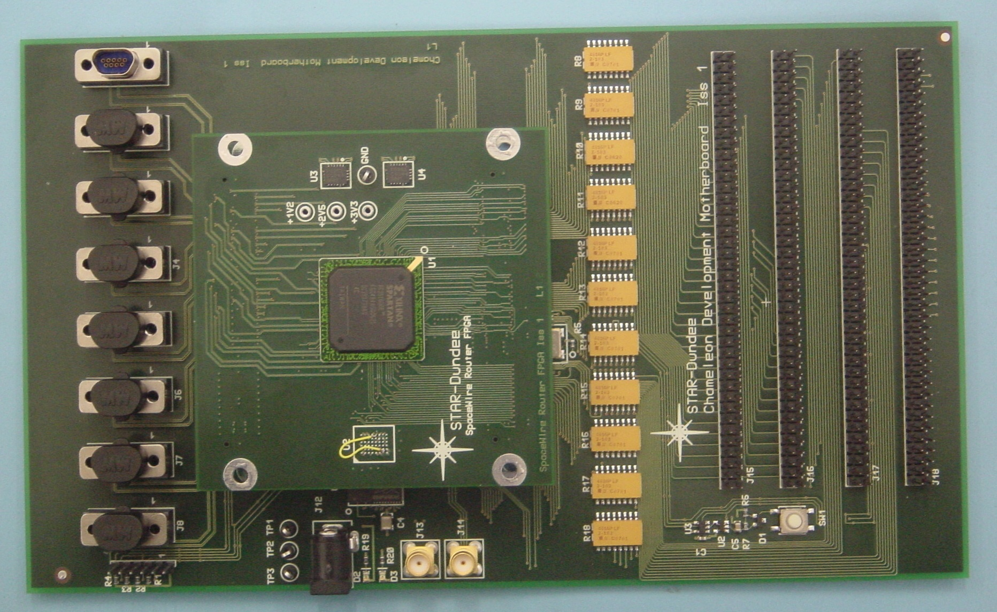
Xilinx Test Board
SpW
Breakout
Connectors
FPGA
Daughterboard

Slide 17
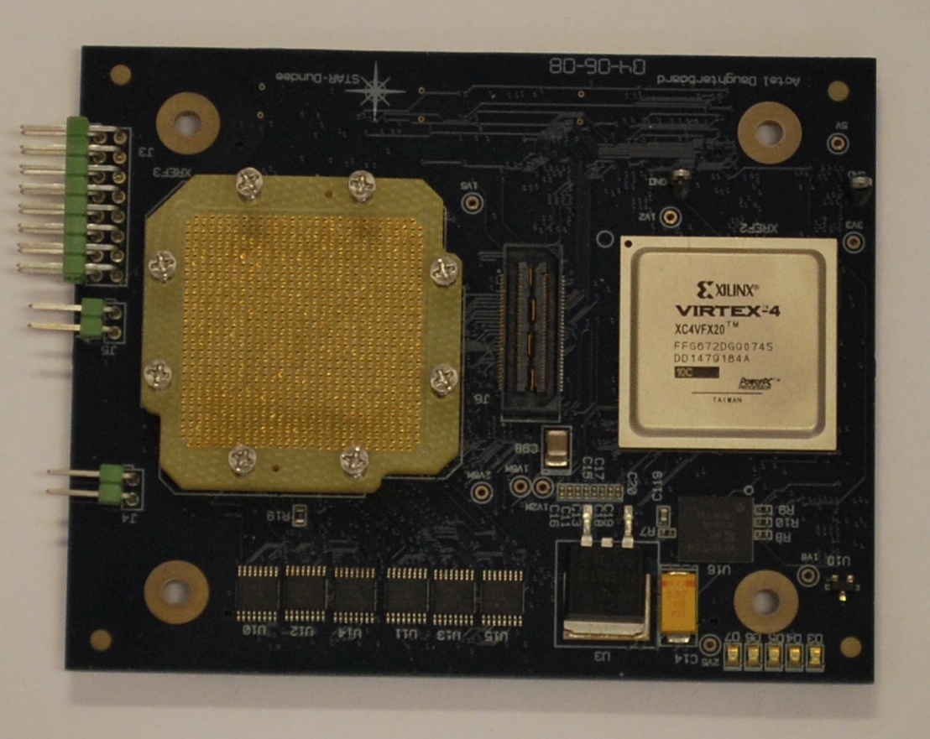
Actel AX1000 Test Board
Actel
AX1000
Xilinx
FPGA
LVDS

Slide 18
Performance RMAP Target
Xilinx Spartan-3 FPGA
  200 Mbits/s transmit and receive
  RMAP core handles data at these speeds
Actel AX1000 FPGA
  Initial implementation
  100 Mbits/s transmit
  150 Mbits/s receive

Slide 19
Footprint
Initial results:
Xilinx Virtex IV (4VFX20)
  889 CLBs (10.4%) RMAP core only
  1168 CLBs (13.7%) RMAP + SpW
Actel AX1000
  2025 modules (17%) RMAP core only
  4551 modules (26%) RMAP + SpW

Slide 20
Current and Future Work
Currently working on initiator design
Once complete will optimise Actel FPGA performance
Two alpha customers running tests on RMAP IP core

Slide 21
Availability
Available from ESA for use on ESA projects only
Available from STAR-Dundee for all other projects

